Slide 1
Request for Proposal
RFP 2024-13: Unarmed Security Guards
Proposer’s Conference
December 17, 2024

Slide 2
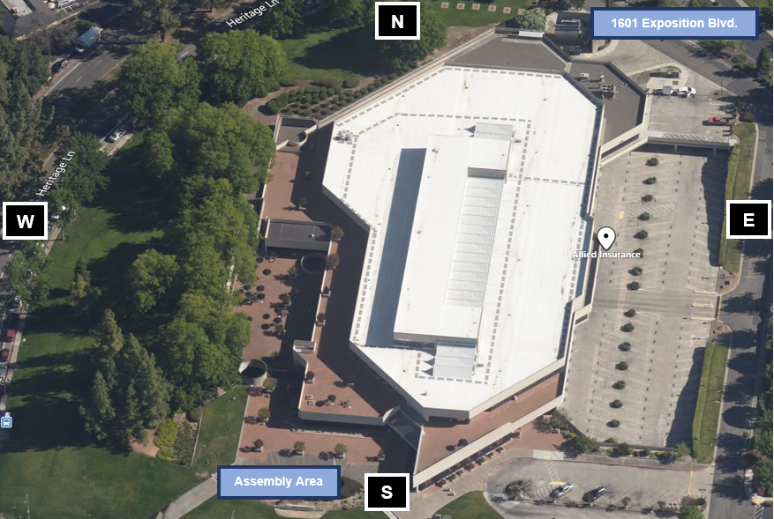
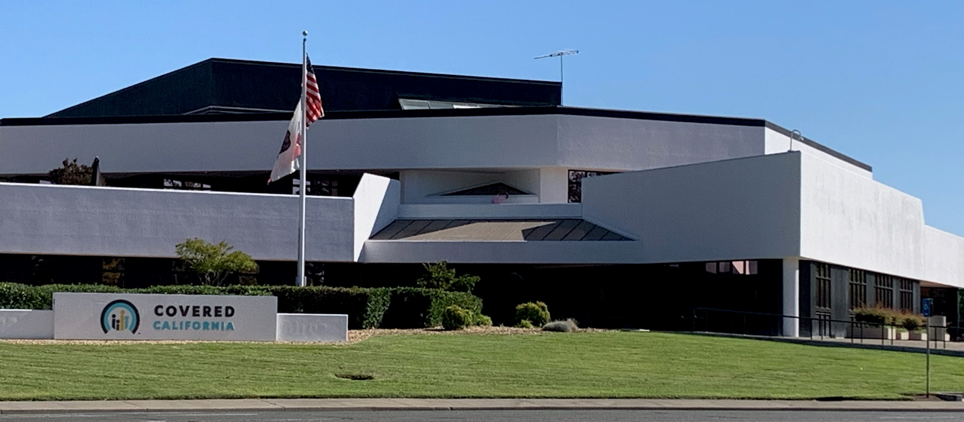
1601 Exposition Blvd.
Sacramento, CA

Slide 3
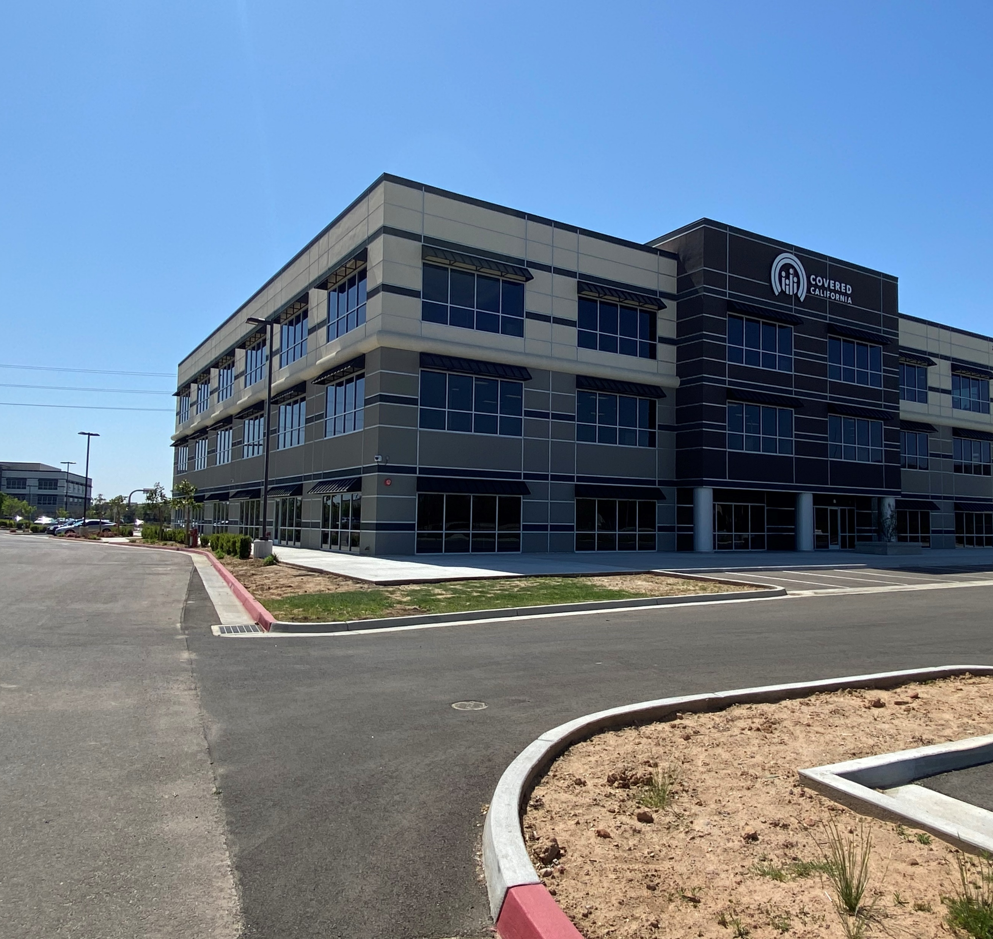
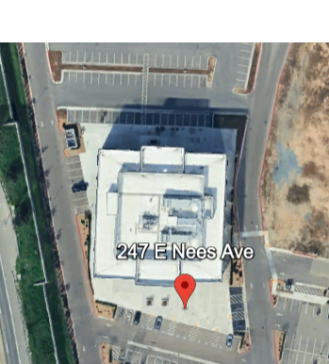
247 E. Nees Ave.
Fresno, CA

Slide 4
RFP
Key Dates
Request for Proposal Release December 3, 2024
RFP Questions Due December 10, 2024, by 12:00 PM
Responses to Questions December 13, 2024
Proposers’ Conference December 17, 2024, 10 AM – 11 AM
Proposal Due January 7, 2025, by 12:00 PM
Notice of Intent to Award Week of January 20, 2025
Anticipated Contract Term: March 2, 2025, to March 1, 2028

Slide 5
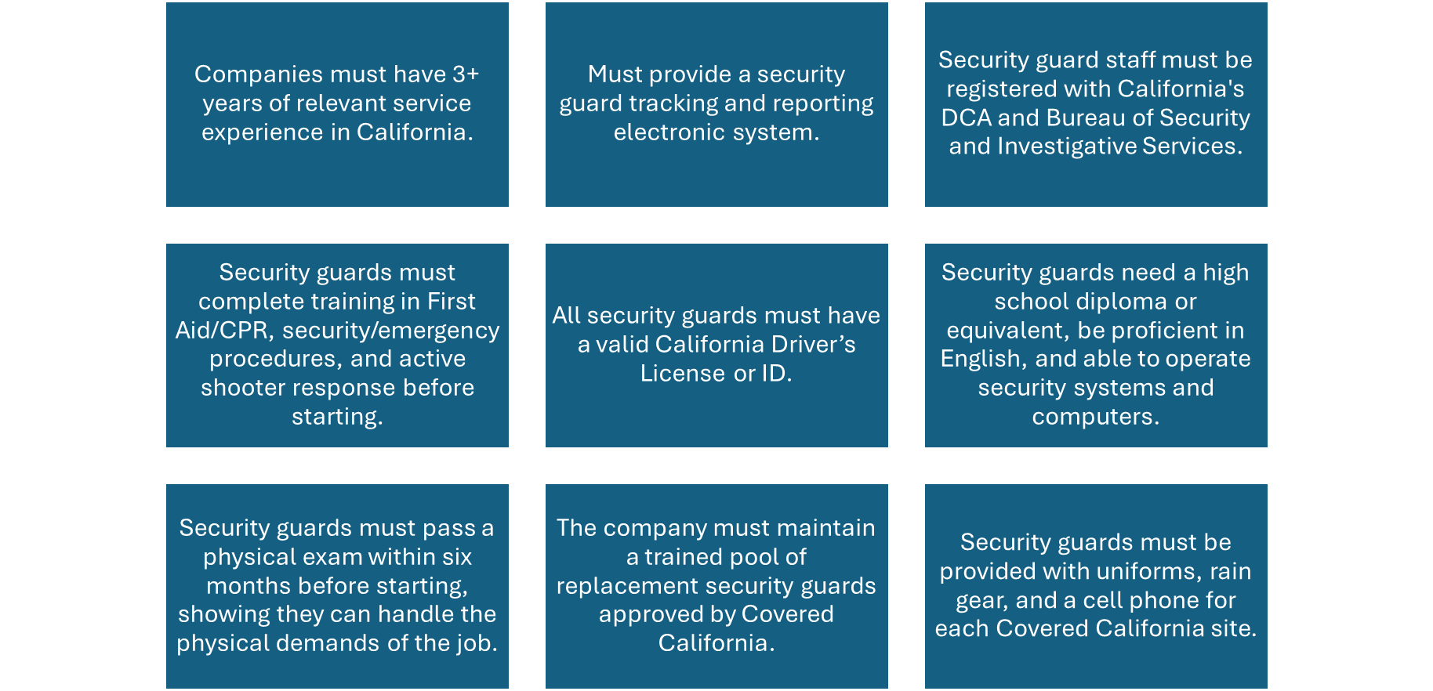
Minimum Qualifications

Slide 6


Work Hours
Covered CA Headquarters
1601 Exposition Blvd.
Sacramento, CA
Covered CA Service Center
247 E. Nees Ave.
Fresno, CA
Normal business hours: 8:00 a.m. to 5:00 p.m. PT, Monday through Friday (excluding State holidays).
Security guard requirements for normal business days:
  One guard from 6:00 a.m. to 2:30 p.m.
  One guard from 7:30 a.m. to 4:00 p.m.
  One guard from 1:30 p.m. to 10:00 p.m.
During Open Enrollment (October through February):
  Work hours may change; may start before regular hours and extend until midnight PST, including State holidays.
  An additional guard may be required.
  Open Enrollment period can change annually.
Additional guards for Open Enrollment or special events will be paid according to Exhibit B-Cost Worksheet.
Normal business hours: 8:00 a.m. to 5:00 p.m. PT, Monday through Friday (excluding State holidays).
Security guard requirements for normal business days:
  One guard from 6:00 a.m. to 2:30 p.m.
  One guard from 9:00 a.m. to 5:30 p.m.
  One guard from 1:30 p.m. to 10:00 p.m.
During Open Enrollment (October through February):
  Work hours may change; may start before regular hours and extend until midnight PST, including State holidays.
  An additional guard may be required.
  Open Enrollment period can change annually.
Additional guards for Open Enrollment or special events will be paid according to Exhibit B – Cost Worksheet.

Slide 7


Administrative Requirements
Proposals must include specific attachments, all of which, if requiring a signature, must be signed by an authorized representative. Both photocopies of wet signatures and electronic signatures are acceptable. These attachments are:
  Proposal Cover Page (Attachment 1)
  Payee Data Record (STD. 204, Attachment 2)
  Contractor Certification (Attachment 3)
  Statement of Economic Interests Certification (Attachment 4)
  Bidder Declaration (GSPD-05-105, Attachment 5)
  Proposal Checklist (Attachment 6)
  GenAI Reporting and Factsheet (STD 1000, Attachment 7)
Upon contract execution, the proposer agrees to submit a completed Statement of Economic Interests (Form 700) for representatives and applicable staff identified as code filers. Further information can be found on Covered California's Conflict of Interest Code and the Fair Political Practices Commission's website.
To claim the DVBE incentive, proposers must also include the completed and signed Disabled Veteran Business Enterprise Declarations (STD. 843, Attachment 8), if applicable.

Slide 8

Required Documents
Mandatory Insurance Documents
Certificate of Liability Insurance with coverage of at least $1,000,000.00.
Workers’ Compensation Liability Insurance evidence.
Automobile Liability Insurance proof, including coverage for non-owned vehicles, with a minimum of $1,000,000.00 per occurrence for individuals performing services under this contract.
Professional Liability Insurance proof.
Compliance and Exceptions
Proposers unable to furnish any of the required insurance certificates or proofs at the time of proposal submission must provide a comprehensive written rationale for such non-compliance.
Covered California reserves the right to consider accepting proposals lacking the specified insurance documents, contingent upon the proposer’s valid explanation for the omission and a commitment to furnish the requisite certificates prior to the finalization of the contract.
A contract will not be executed without the acquisition of the essential insurance certificates. Failure to provide the necessary documents before contract execution will lead to the contract being awarded to the next highest-scored proposer.
Corporate Proposer Requirements
Incorporated proposer organizations must demonstrate their Active status with the California Secretary of State (SOS) by providing either: a. A current Certificate of Status issued by the SOS. b. A copy of the proposer’s Entity Detail page from the SOS’s Business Search website.

Slide 9
Response to the Model Contract
Using the Model Contract Exhibit A – Scope of Work and Exhibit A, Attachment 1 – Work Authorization provided, include a revised Exhibit A – Scope of Work with suggested tracked changes in Microsoft® Word®.
Using the Model Contract Exhibit B – Budget Detail and Payment Provisions and Exhibit B, Attachment 1 – Cost Worksheet provided, include a revised Exhibit B – Budget Detail and Payment Provisions with suggested tracked changes in Microsoft® Word®.
Using the Model Contract Exhibit C – General Terms and Conditions provided, include a revised Exhibit C – General Terms and Conditions with suggested tracked changes in Microsoft® Word®.

Slide 10

Technical Requirements
Understanding and Approach
(no more than 5 pages)
Corporate Qualifications
(no more than 5 pages)
Project Team Qualifications
(no more than 5 pages) *Resume for project team
Past Projects Completed
(no more than 5 pages)
Project Assumptions
(no more than 5 page)
https://hbex.coveredca.com/solicitations/#RFP-2024-13

Slide 11
RFP 2024-13: Unarmed Security Guards
Questions and Answers
RFP 2024-13: Unarmed Security Guards
1. Who is the current incumbent and how long have they serviced Covered California?
The current incumbent is National Security Industries. They have been servicing Covered California for 5 years.
2. What is the preferred uniform type/style?
Standard Company uniform with identifying company patches. No jeans, skirts or outward facing t-shirts. Ties are not required. For more information, please see Exhibit A, Section H, 1- 8.
3. Are there any special training requirements? Ex. First Aid/CPR/AED, etc.?
Please see RFP Section 2.1.4.
4. Is there any equipment provided by the State?
Covered California will provide a desktop computer, desk phone, printer, and walkie-talkie.
5. What other equipment is required for the Security Professionals?
Guards: Cell phone, rain attire (boots, jackets, umbrellas, hats). Please see RFP Section 2.1.2 for more information.
6. What is the State’s standard payment terms?
Please refer to Exhibit B of the Model Contract for detailed information about the State’s Payment Terms.
7. Is the State exempt from payment of state and local sales and use taxes?
The rates are fully loaded rates, per the language in the model Contract, Exhibit B – Attachment 1. Addendum 1 adds clarification language about state and local tazes being inclusive of the fully loaded rates.
8. What challenges is the State experiencing at the various sites?
The State has not experienced any challenges at either site.
9. Does the State have a preference to retain incumbent employees that are in good standing and meet the hiring criteria of the Proposer?
Covered California does not have a preference, but would consider hiring incumbents.
10. Are there restroom facilities in close proximity to all of the posts at all sites?
Yes.
11. For inclement weather, is there shelter available for the security professionals at all sites?
Yes.

Slide 12
Unarmed Security Guards
Questions and Answers
(continued)
RFP 2024-13: Unarmed Security Guards
12. How are security officers relieved when taking required Rest and Meal Breaks?
They will relieve each other with overlapping shifts.
13. Are the security officers given 30 minute unpaid or paid breaks?
Security Officers are provided two (2) 15-minute paid breaks and one (1) 30-minute unpaid lunch
14. Is the current security workforce covered by a collective bargaining agreement with their employer? If so, will a copy of the CBA be provided, since vendors may be legally bound to honor economic aspects of that CBA?
No.
15. What is the reason for going out to bid for security services?
To obtain a larger pool of bidders
16. Is employee parking available to the contractor’s employees? If so, is there a fee associated with parking?
Yes, parking is available to the contractor’s employees. There is no fee associated with parking.
17. Do Prime contractors who are not a certified SB, MB, DVBE’s required to subcontract a minimum of 25% to a certified SB, MB or DVBE?
No, there is not an SB/MB/DVBE requirement with this RFP.
18. If so, is the 25% based on overall revenue or does 25% need to be subcontracted at each location?
There is not an SB/MB/DVBE requirement with this RFP.
19. Will the use of Armed personnel ever be requested or has it ever been a service need under Covered California locations?
No, the use of Armed personnel will not be requested at any of the Covered California locations.
20. On Page 21, Section 4.2.3, Updated Model Contract with Exhibits, to confirm our understanding, are bidders required to submit this Model Contract: With tracked changes, or Without any changes?
Please submit with any proposed changes in track changes.
21. Additionally, should we fill in the corresponding areas with our company information, or should we leave it as is? Please advise.
No need to complete the corresponding areas with the company information. Please leave that information blank.

Slide 13
Unarmed Security Guards
Questions and Answers
(continued)
RFP 2024-13: Unarmed Security Guards
22. Is Exhibit B- Attachment 1, Cost Worksheet in the Model Contract Documents the form in which our cost proposal should be submitted, using this Word. Form doc.? Which we can convert in a PDD upon Submittal, please clarify?
Yes, must be submitted using the Word document.
23. Could you please confirm if this contract is subject to prevailing wage requirements?
Yes.
24. Are there any bond requirements for this contract?
No, there are not any bond requirements for this contract.
25. For the additional Hours During Open Enrollment Period (October through Feb) will Overtime be applicable?
Yes.
26. For the required hours at 247 E Nees Ave, we’ve noted that 9-hour shifts are specified for Guard 1 and 2 shifts. Could you please clarify if this includes a 1-hour unpaid lunch break, or if the lunch break is 30 minutes with the remaining 30 minutes being considered overtime? Your clarification on this would be greatly appreciated.
The schedule at the E. Nees location in Exhibit A has an error, the lunch breaks for all guards are 30 minutes and unpaid. All shifts are currently 8 hours, not 9.Addendum 1 will be released to correct this error.
27. Will the additional guard hours for Open Enrollment vary? If so, could you provide an estimate of how many hours are expected per additional request, or if there is any flexibility in the number of hours requested?
Yes, the number of hours will vary by location and need. Covered California estimates that it would be approximately 40 hours per month, which does include weekends.

Slide 14
Unarmed Security Guards
Questions and Answers
(continued)
RFP 2024-13: Unarmed Security Guards
28. Will we be required to provide company patrol vehicles, please clarify as we note on page Exhibit am Attachment 1 under A. Limited Scope of work or Tasks, guard are required to possess a Valid Driver License?
No vehicle is required, but all guards are required to possess a Valid CA Driver’s License for identification purposes and as they may drive to/from work.
29. Will the contractors have a secure location to be able to have guard’s equipment such as cellphone and radios to be charged and or stored, if needed?
Yes.
30. Will parking be provided to the guards working at each location?
See question 16 above.
31. While preparing our response to the RFP, we’ve found it challenging to adequately elaborate on our experience, qualifications, and approach within the specified 2-3 page limit per section. This constraint limits our ability to comprehensively describe how we will proceed and schedule our security team to meet your needs effectively. Can the page limit be revised to provide a more detailed and complete response?
Yes, this will be allowed but please limit it to no more than five (5) pages. Addendum 1 will be released with this new information.
32. If we have no changes to the Model contract and accept all terms, do we still need to attach the Model contract and all its Exhibits with our proposal.
Yes, please attach the model contract as acceptance of all terms and exhibits.
33. Could you verify that the minimum Blended hourly rate of pay to Security guard working on this project ( GC 19134) for 2025 will $28.70 plus CALHR adjustment for 2025?
Yes; however, the pay rate depends on the location.
34. The Proposal Checklist states that model contract with exhibits is required to be returned with the proposal. Is that correct? I understand some of the documents being returned but on some there aren’t, for instance Exhibit C – General Terms and Conditions.
Yes, please attach the model contract as acceptance of all terms and exhibits

Slide 15
Questions?

